Slide 1

07
Autonomous Coffee Maker

Slide 2
Component List
180° Servo (3)
360° Servo (1)
DC Air Pump (2)
Water Level Sensor (1)
Arduino Uno (1)
Raspberry Pi (1)
Coffee Maker (1)
Contact Switch (1)

Slide 3

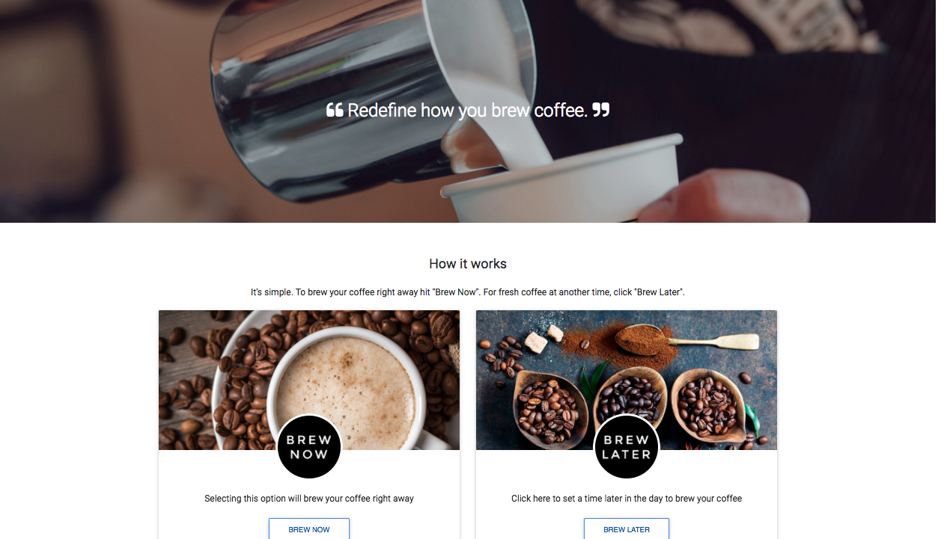
Website

Slide 4



Server
php
‘S’ - no request
‘G’ - request
fwrite(f);

Slide 5



Raspberry Pi
Python client
Server script
port 9001
Serial port

Slide 6


Start by choosing when to brew coffee from our website

Slide 7
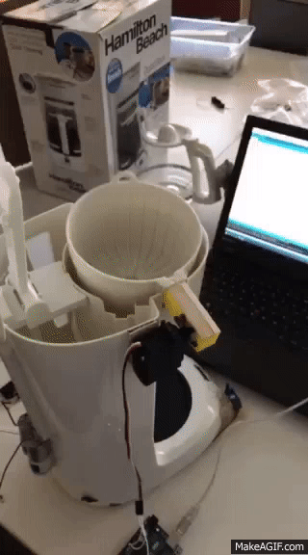
Then the coffee maker removes the old filter

Slide 8
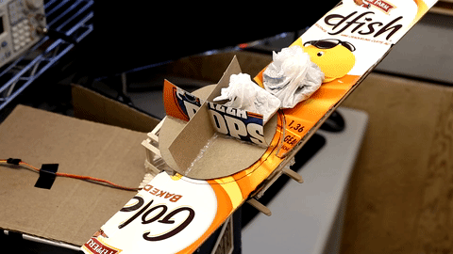
Next the coffee filter pod is inserted

Slide 9
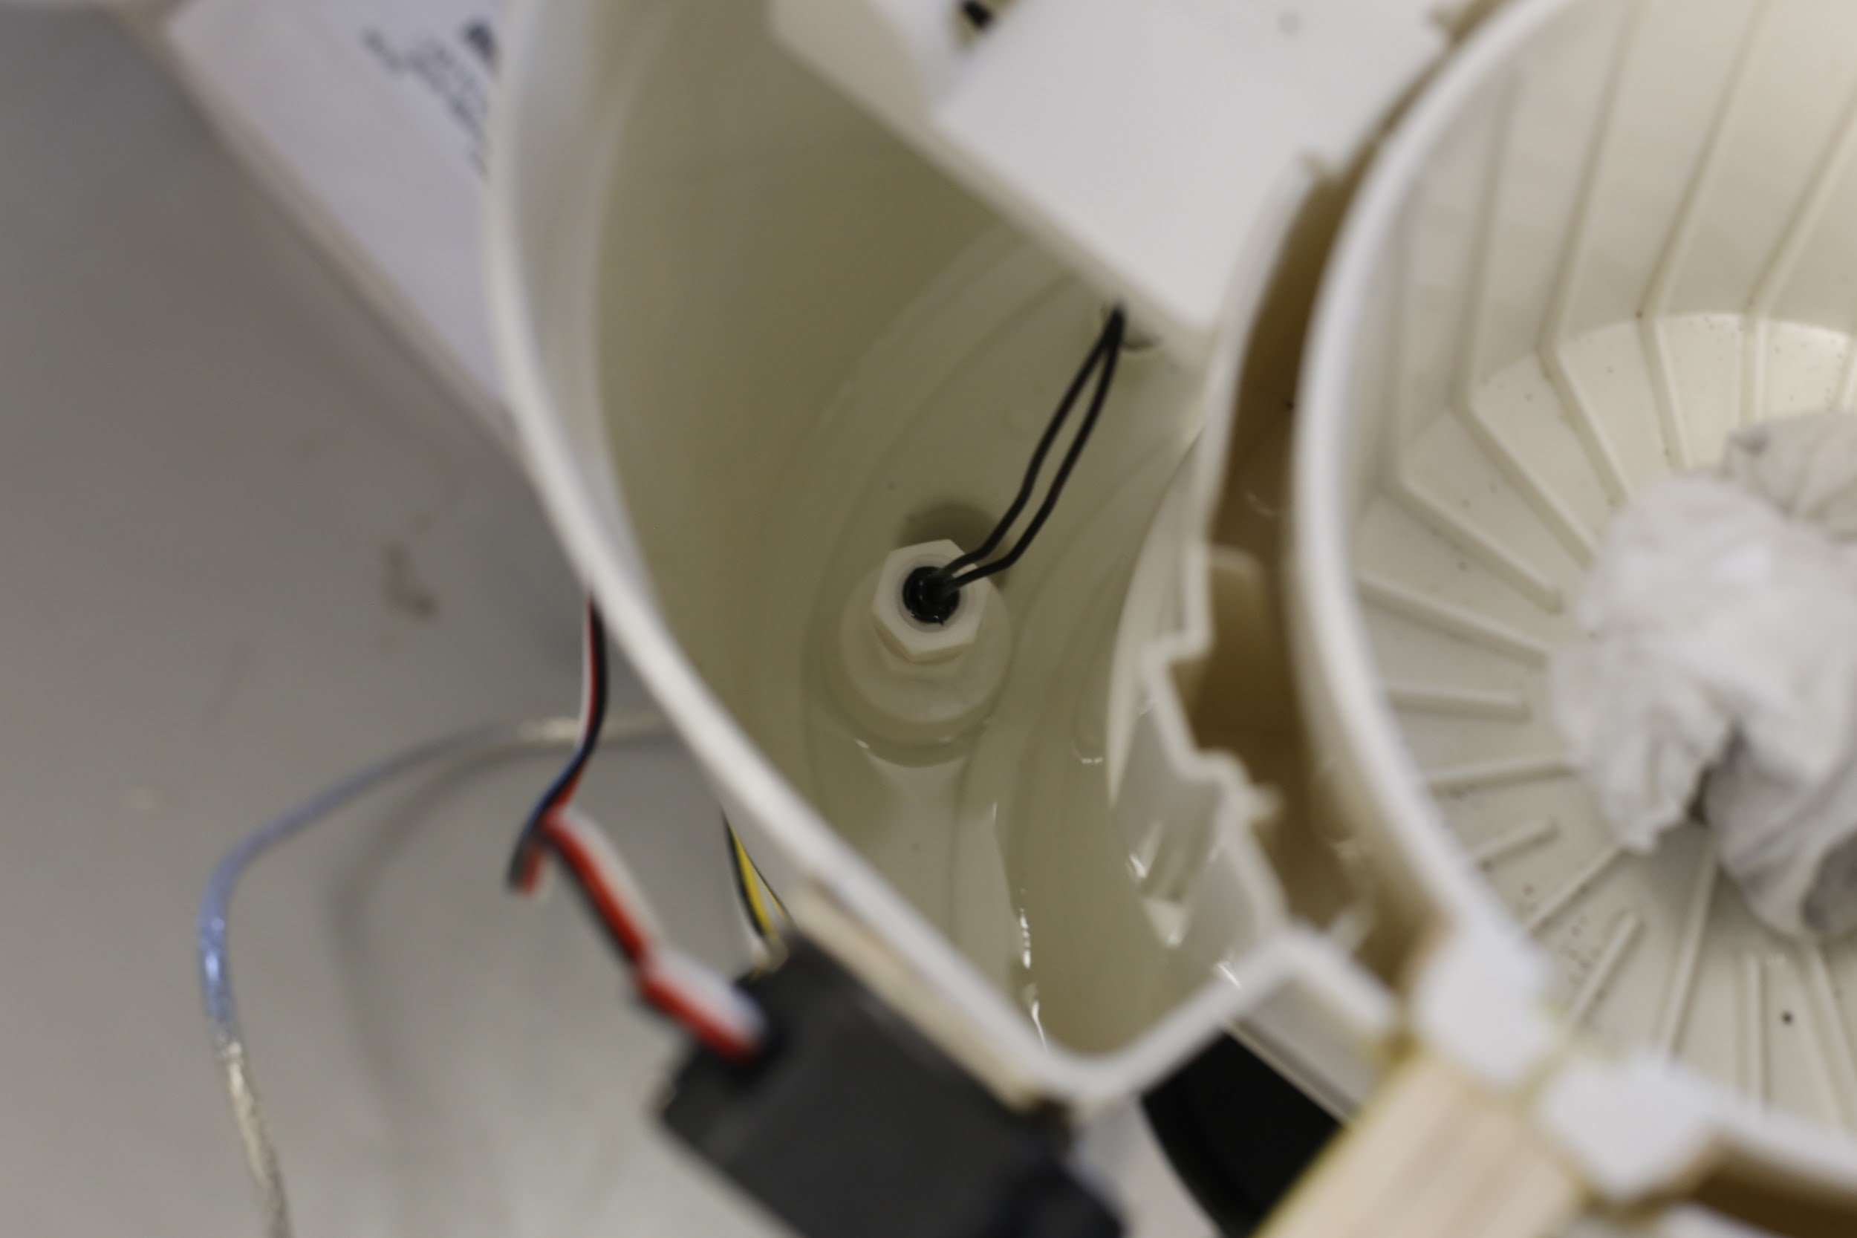
Water is then pumped from the reservoir into the coffee maker

Slide 10
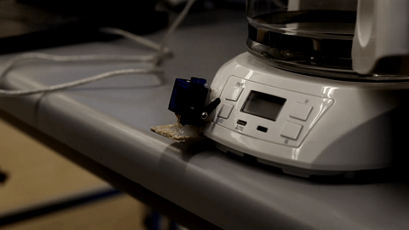
Lastly, the coffee maker is turned on

Slide 11
There is also a cream dispenser

Slide 12
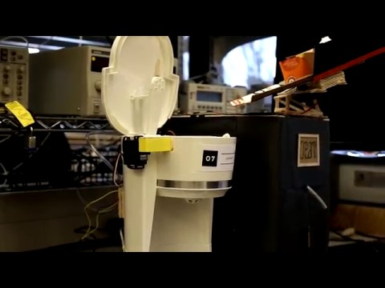
Here’s our full brew

